Slide 1
Microsoft Power BI: Python Scripting
Muhammad-abdullah
P19-0036

Slide 2
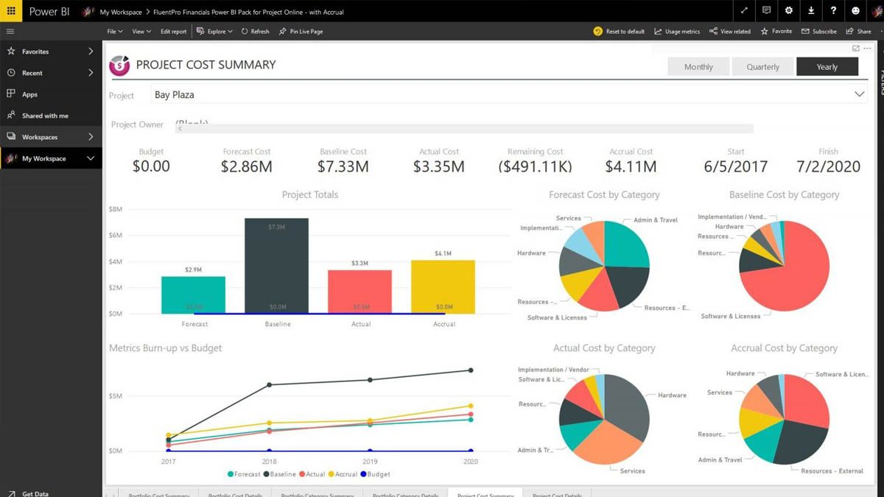
What is Power BI?
Power BI is an interactive data visualization software product developed by Microsoft.

Slide 3
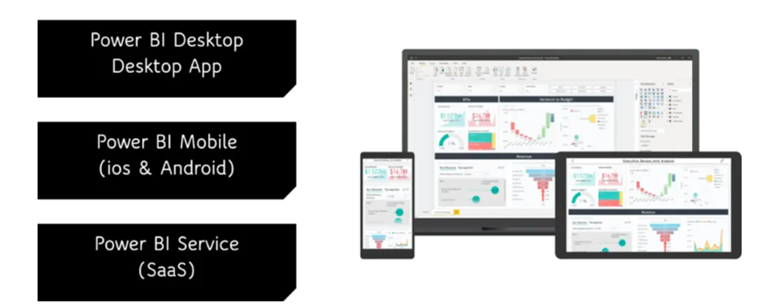
Power BI Platforms

Slide 4
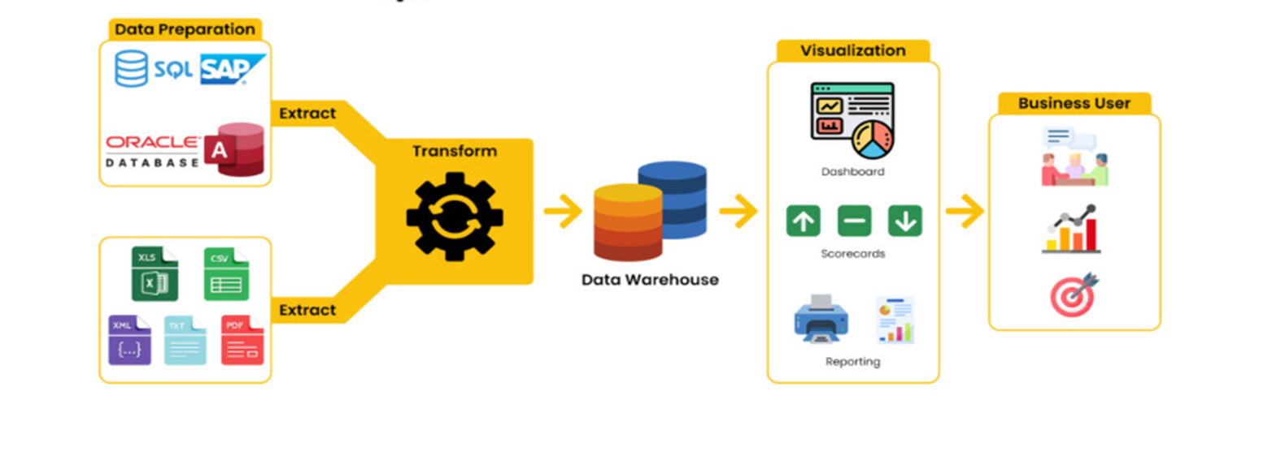
Power BI Architecture

Slide 5
Lets try to visualize data by using python scripts on power bi desktop.

Slide 6
Any Questions?

